Slide 1

Classification of Family Domain of Amino Acid Sequences using CNN – LSTM Architecture
Gokul S – 2018103026
Steven Gilbert – 2018103071
CSE P

Slide 2



Introduction
In the field of micro biology, understanding the relationship between amino acid sequence and their protein functions can yield far-reaching scientific implications.
But current lab techniques cannot annotate even 1/3 of microbial protein sequences.
Predicting the function of a protein from its raw amino acid sequence is a critical step for understanding the relationship between genotype and phenotype.
We propose a Deep-learning method which consists of a CNN-LSTM hybrid architecture to classify the families of the amino protein sequences.

Slide 3


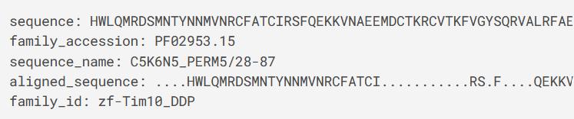
Pfam
The Pfam database is a large collection of protein families, each represented by multiple sequence alignments and hidden Markov models(HMM).
For each family in Pfam :
Family Description
Multiple alignments
Protein domain architecture
Species Distribution
Known protein structures
The Dataset contains nearly :
1 million sequence examples
Around 18,000 family output classes

Slide 4
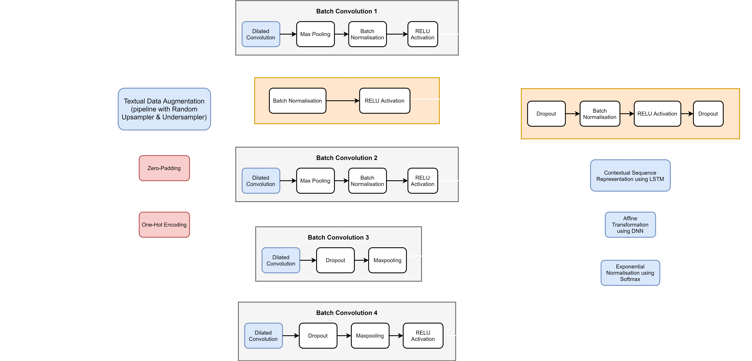
Block Diagram

Slide 5
Methodology
EDA
In this module, various plots are used to analyze the structure and distribution of the PFAM dataset in order to check the balance among families
Preprocessing
Here we first create a dictionary bases on vocabulary. Then encoding occurs with sequence padding along with vectorization
Model Creation
The overall CNN-LSTM architecture is concretely defined here and compiled along with predetermined hyperparameters.
Training
Prediction
The trained model is loaded to perform Amino acid sequence classification of a completely new and unseen input sequence
The model is trained on a Quadro P5000 GPU for 50 epochs to learn the important characteristic features of each of the individual 500,000 sequences.

Slide 6
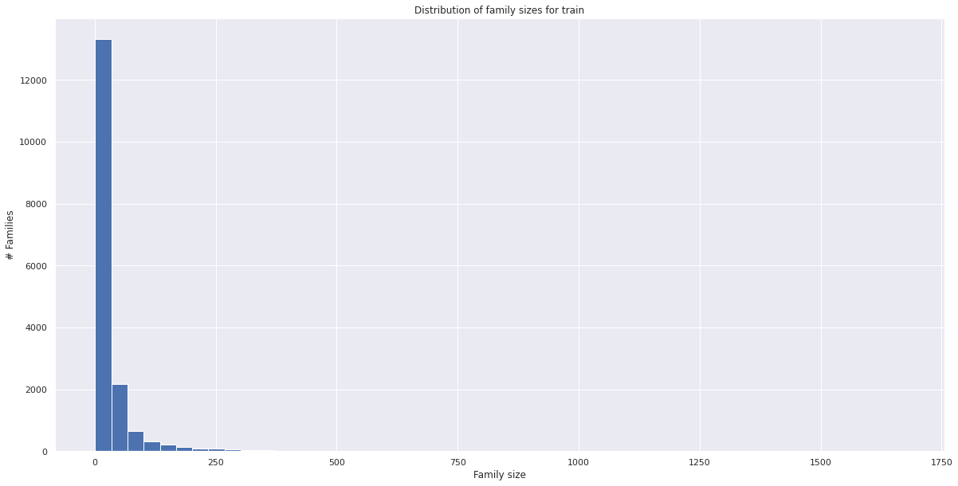
Exploratory Data Analysis
Distribution of Train Family Sizes

Slide 7
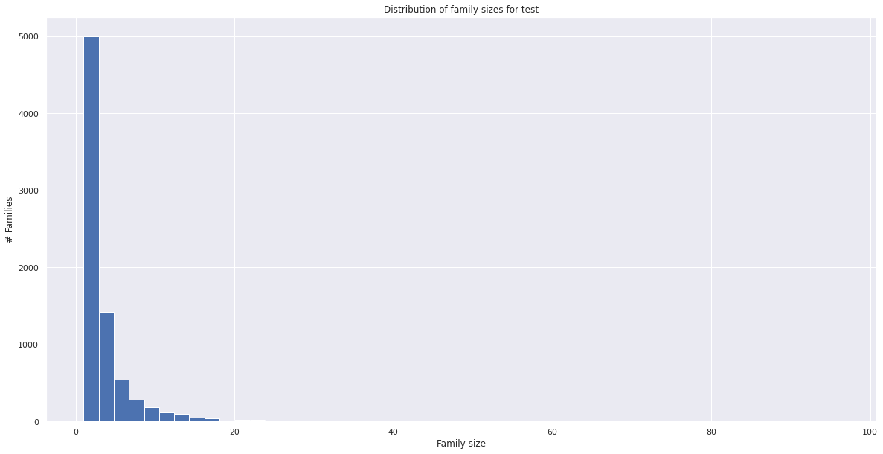
Distribution of Test Family Sizes

Slide 8
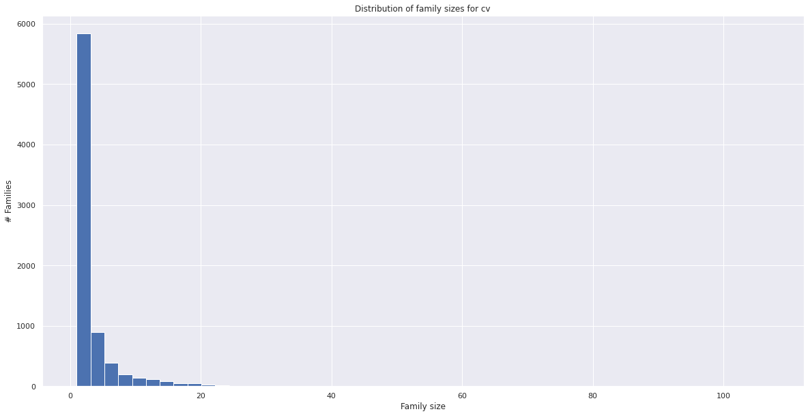
Distribution of Cross Validation (CV) Family Sizes

Slide 9
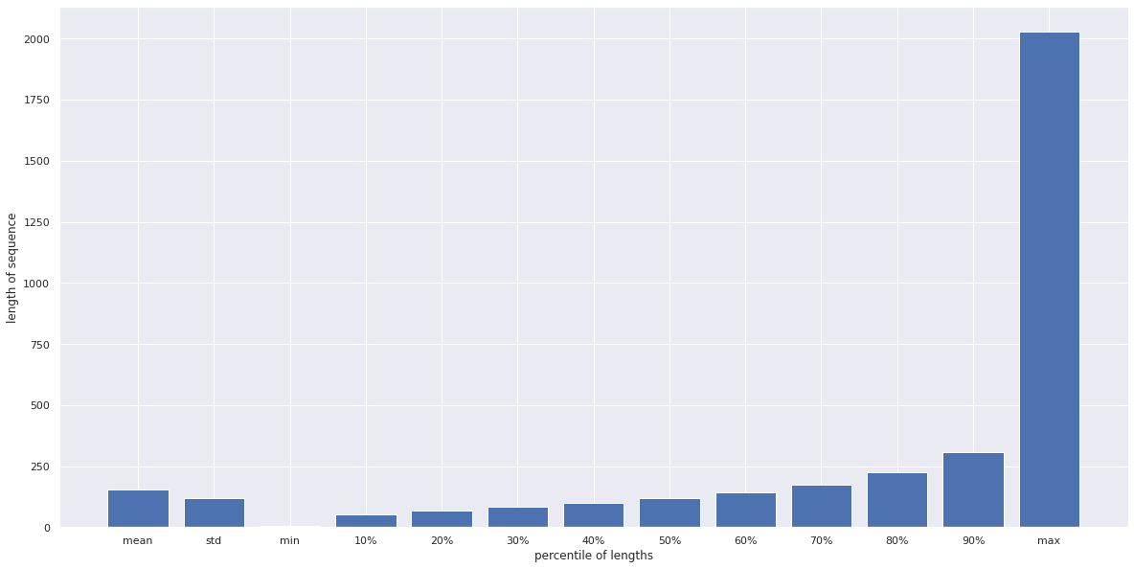
Percentile Distribution of Sequence Length
Train

Slide 10
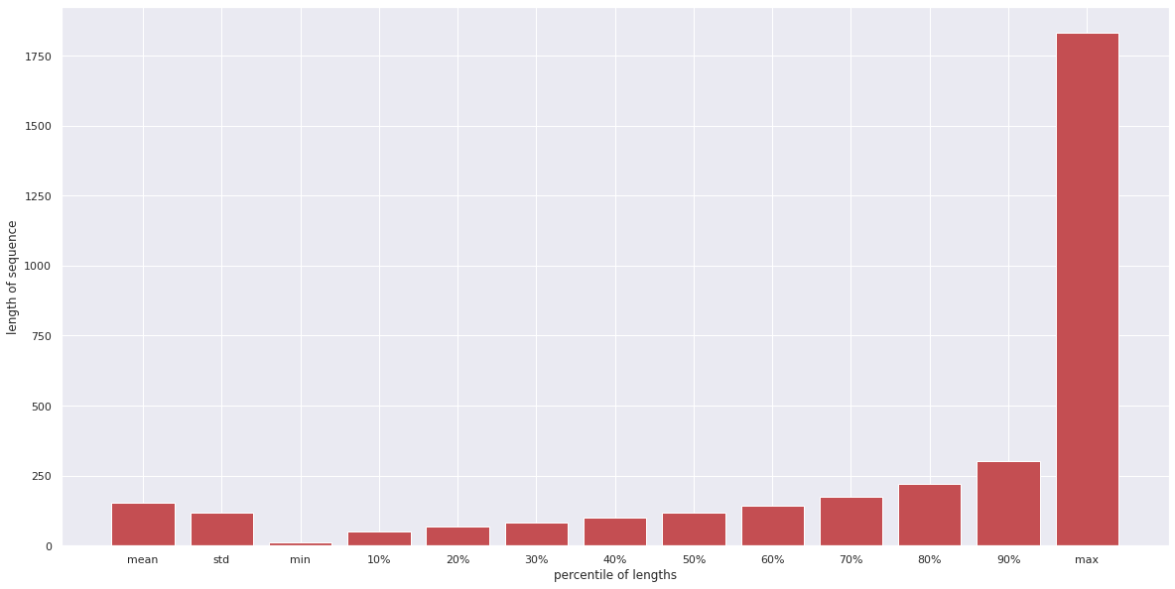
Test

Slide 11
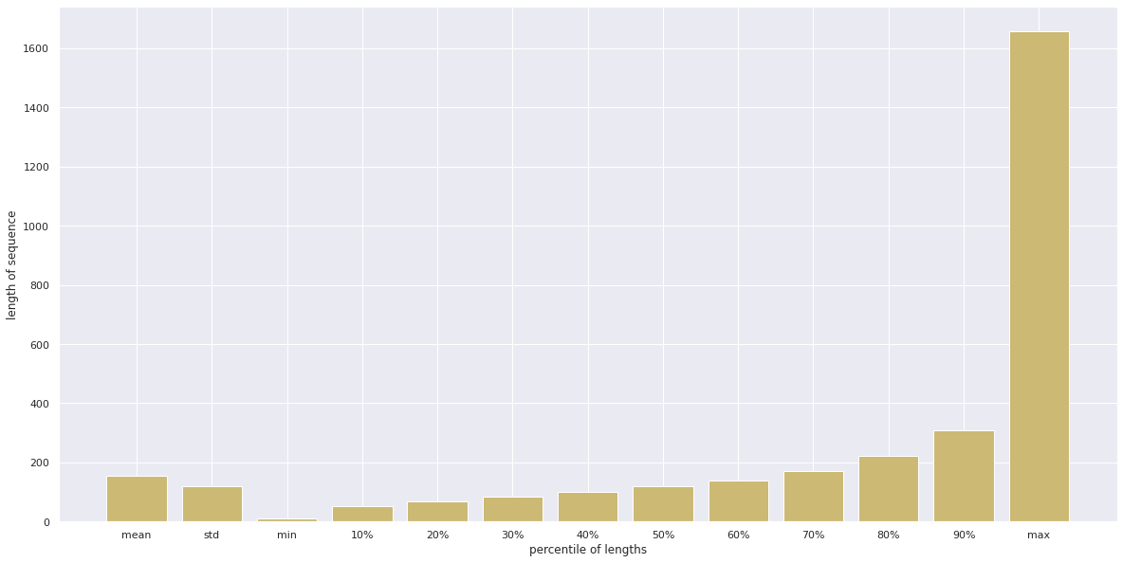
Cross Validation

Slide 12
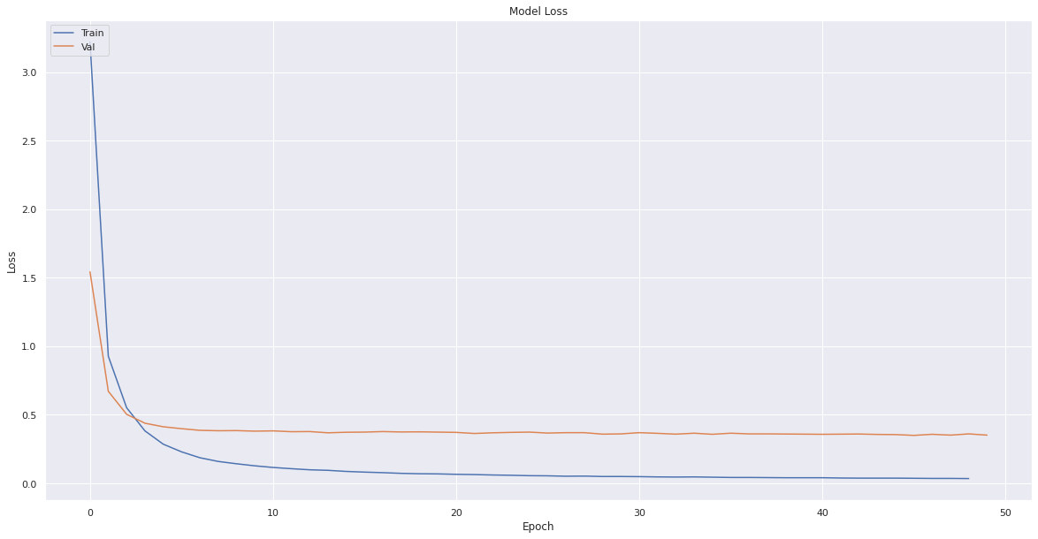
Loss Curve
Model with LSTM and Dilated 1-D convolution

Slide 13
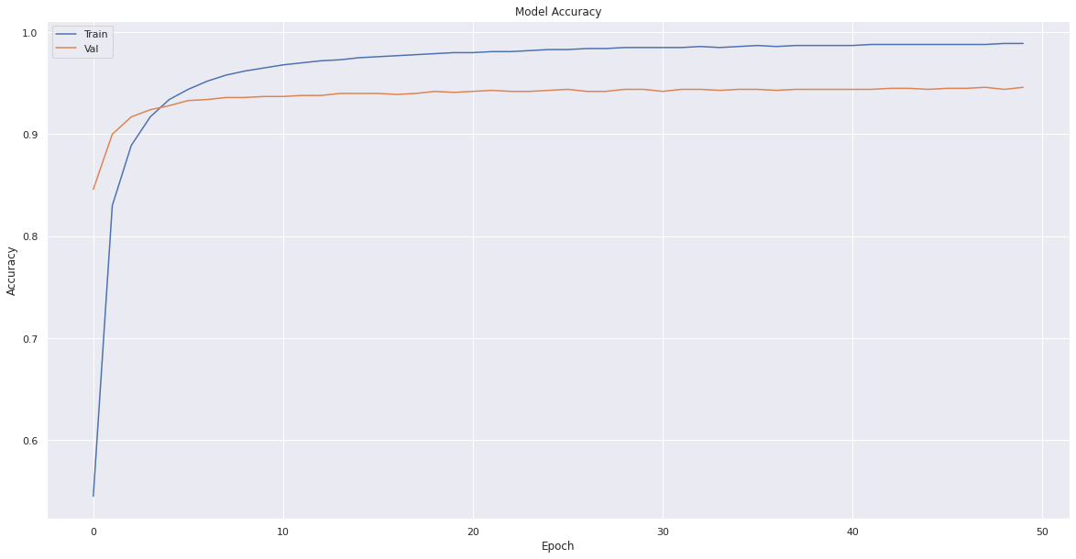
Accuracy Curve
Model with LSTM and Dilated 1-D convolution

Slide 14
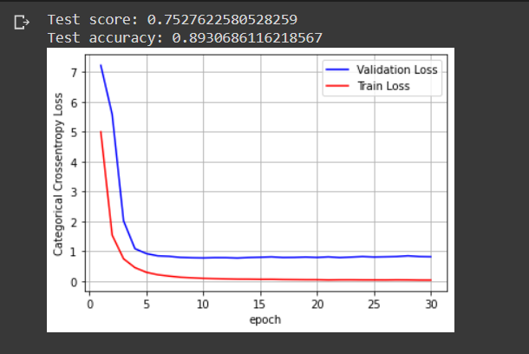
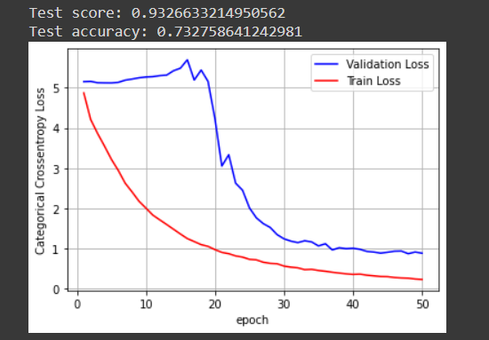
Old Model
Model without LSTM and normal 1-D convolution
With Data Augmentation
Without Data Augmentation

Slide 15
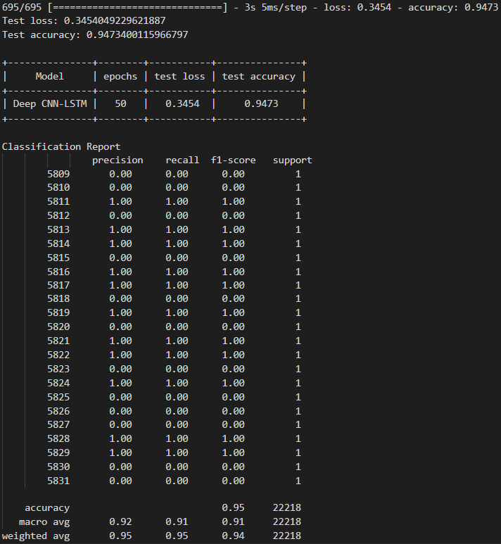
Performance Metrics
Model with LSTM and Dilated 1-D convolution

Slide 16
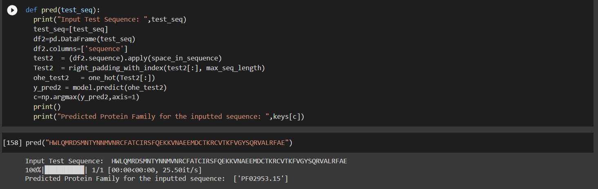
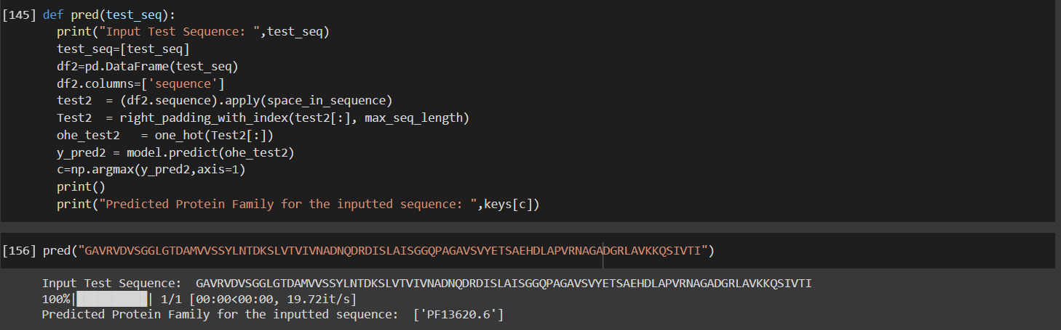
Predictions

Slide 17
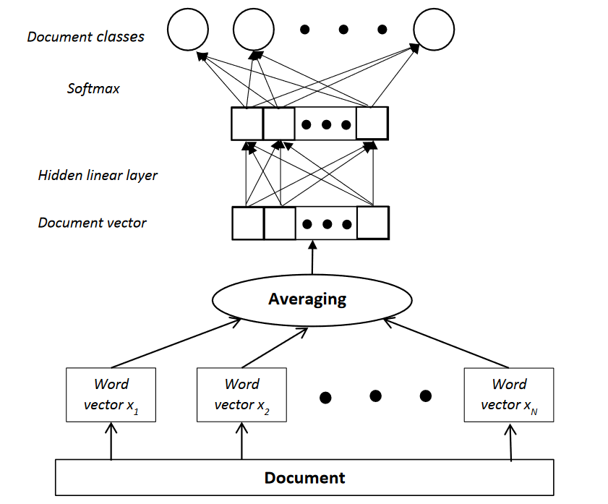
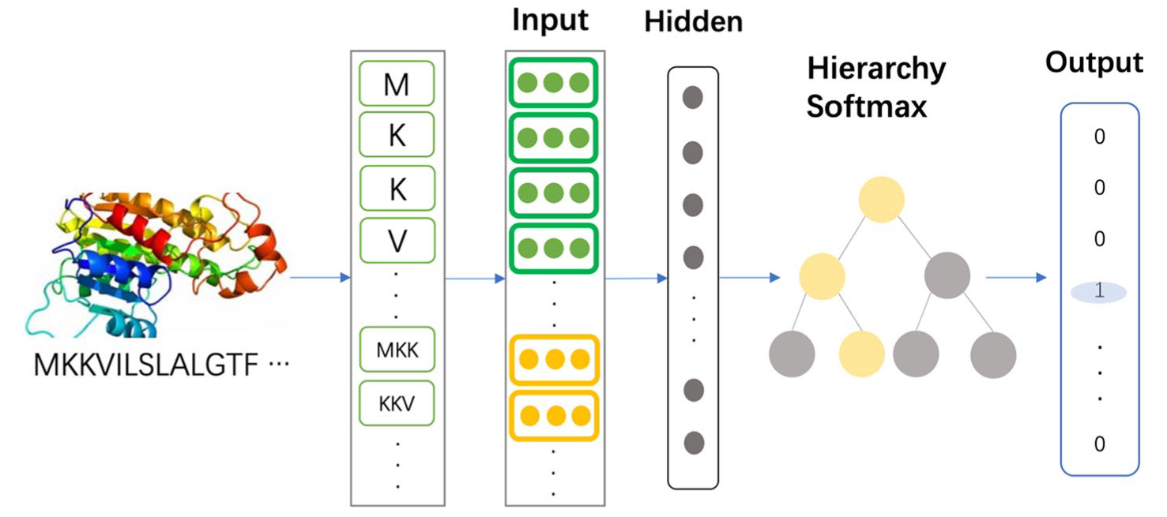
FastText – Architecture Diagram

Slide 18
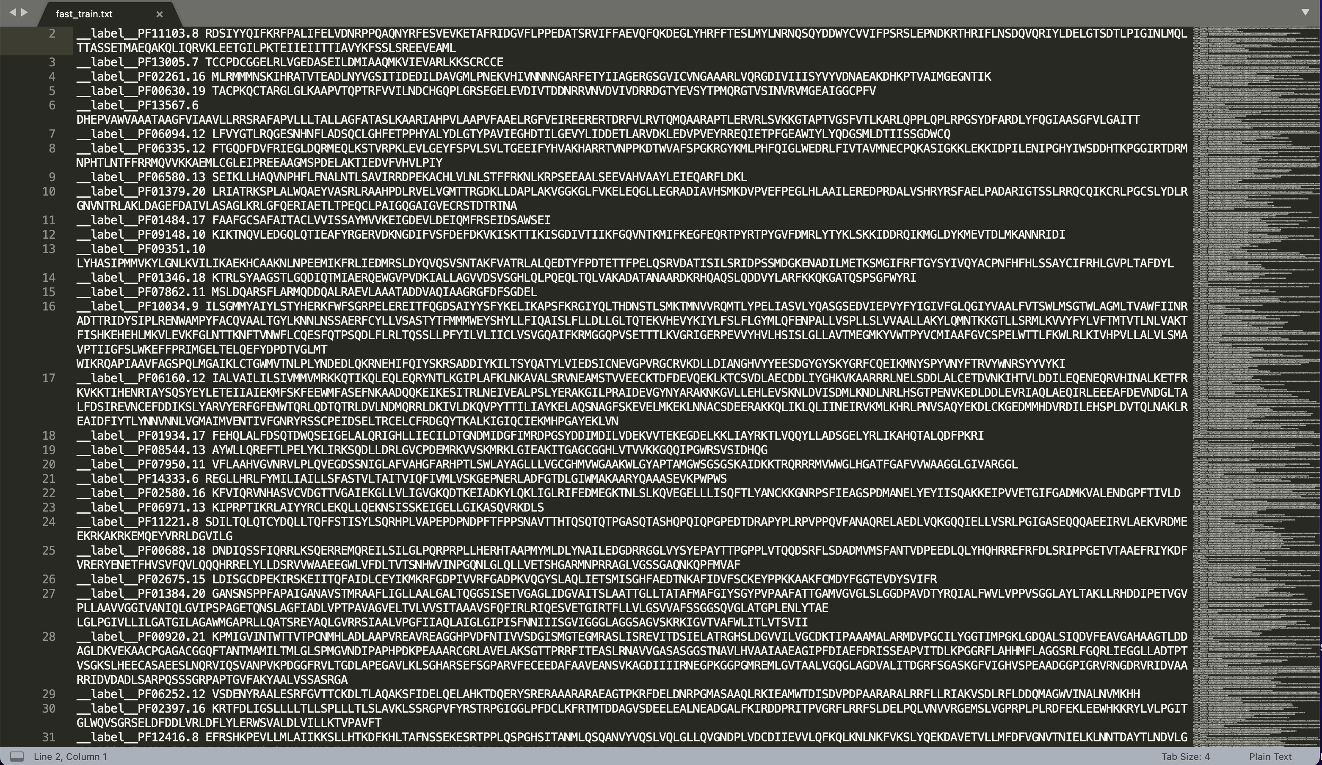
FastText – Input Format

Slide 19
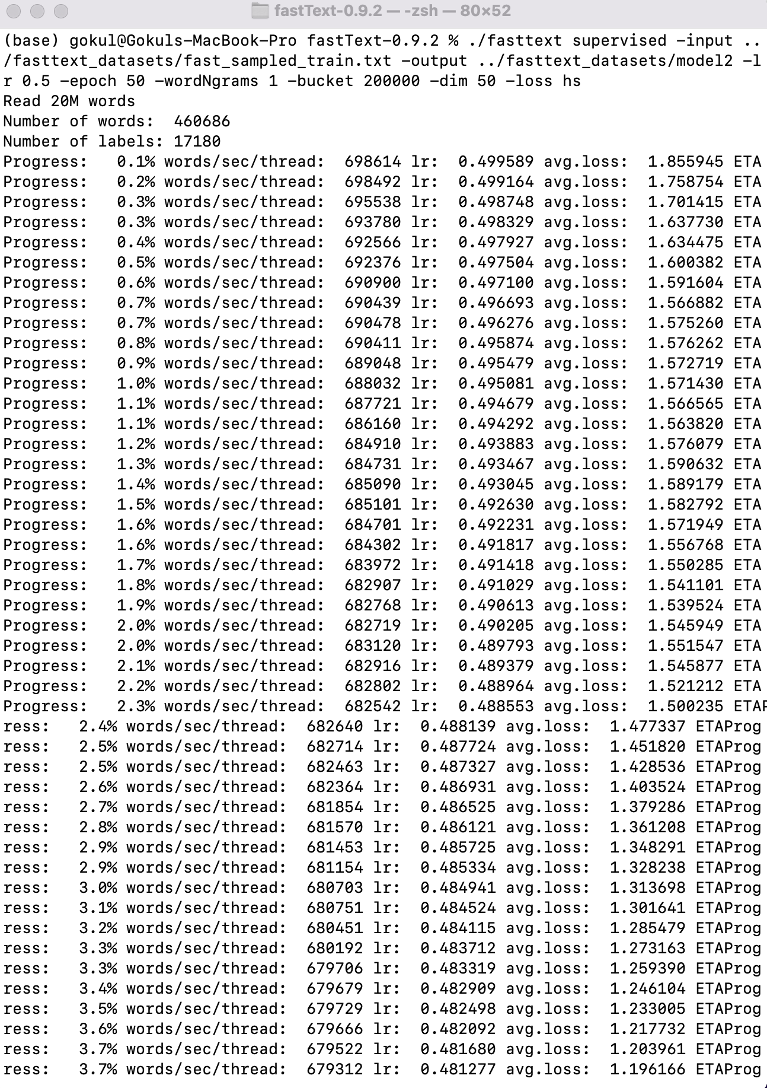
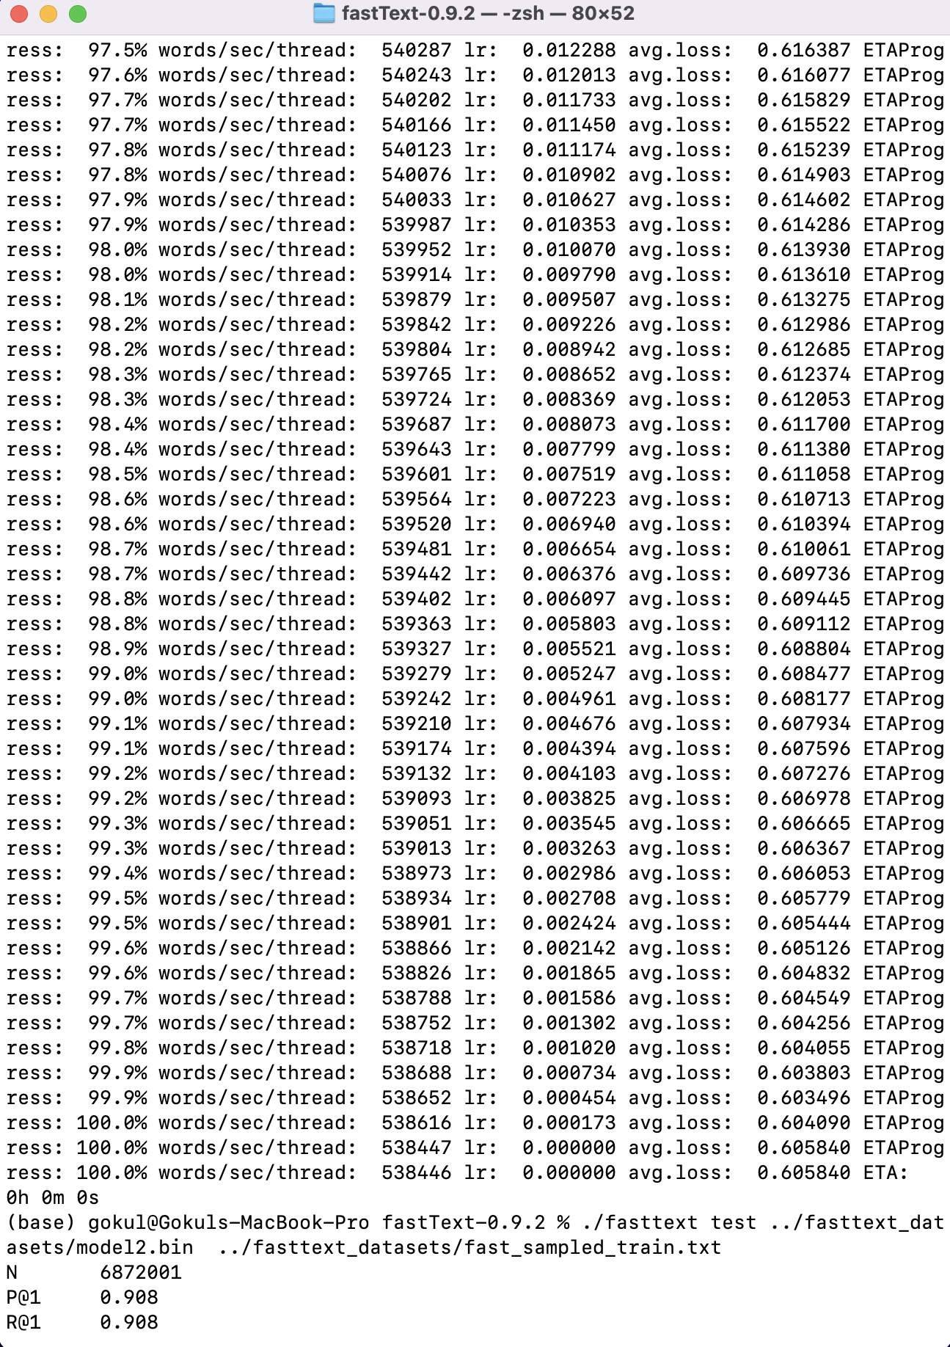
FastText Model – Training Logs

Slide 20
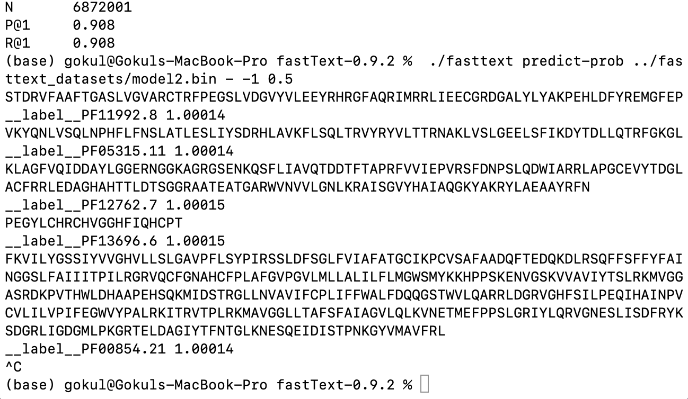
FastText Model
Predictions
Hyper-Parameters
FastText Embedding Model = 50
Loss = Hierarchical Loss
Bucket Size = 200,000
Learning Rate = 0.5
Epochs = 50
Word N-Grams = 1

Slide 21
Inferences
CNN-LSTM Model
FastText Model
Using a Dilated CNN instead of a normal one proves to be more efficient as the field of reception is spread. This results in a more wider field of view with the same number of kernel parameters and same computational complexity.
In order to combat the problem of a highly imbalanced dataset, we first over-sample the minority classes using RandomUpsampler and then under-sample the majority classes with an appropriate sampling rate using a RandomUndersampler.
Using an LSTM layer post 4 sequences of batch convolutions helped the model learn a contextual representation of the amino acid sequence, which is extremely important when it comes to sequence classification problems.
This improved our test accuracy from 0.8936 to 0.9473 (5.37% improvement).
Usage of batch normalization sped up training by normalization the hidden layer activation and handling internal covariate shift.
Under-sampling the majority classes to 400 samples and up-sampling the minority classes to the same size has helped the FastText model to learn a good representation of the PFAM protein database by achieving a P@1 and R@1 score of 0.908.

Slide 22

Summary
Identification of a family of a protein sequence is crucial as it give scientists and researchers a reference point, to which based on the family they can attribute it to known properties. This can prove very useful when identifying the sequence of an unknown disease, to identify its family and to create a potential vaccine based on it’s family properties.

